Slide 1
Weather and climate
Part-2

Slide 2
Atmospheric Pressure
The pressure that the atmosphere exerts on the surface of the earth because of its weight.
There is a close relationship between pressure and temperature- high temperature means low pressure and vice versa.
Pressure difference causes horizontal movement of air – Wind and vertical movement-Current, which together cause circulation of air in the atmosphere
Measured- Barometer
Not the same every where and varies from time to time, mainly varies with altitude and temperature.

Slide 3
Altitude
Places at great heights experience less atmospheric pressure than places at sea level, because there is a greater amount of air pushing down on the surface at sea level than at a higher altitude.
Pressure decreases as altitude increases

Slide 4
Temperature
The temperature of a place increases, the air gets heated, expands and rise, it leads to decrease in air pressure in the area.
When the temperature falls, the air gets cold, contracts, and descends downward, it leads to an increase in air pressure.
Air pressure decreases with an increase in temperature.
That is why areas close to the equator generally have low air pressure.

Slide 5
Wind
Air in motion
Blows from a region of high pressure to a region of low pressure.
A horizontal movement of air that helps in the transfer of heat on the surface of the earth.
It cannot be seen but is felt.
It has both direction and speed and, therefore, can be measured.

Slide 6
Contd..
In the Northern hemisphere- North –East Trade Winds
Southern hemisphere- South- East Trade Winds
Direction is determined by Ferrel’s Law which states that a body moving over the surface of the earth will be deflected to it's right in the northern hemisphere and left in the southern hemisphere.
Coriolis force caused by the rotation of the earth and applies particularly to oceanic and air movements.
Whenever these winds blow onshore, i.e, from the sea to land, they pick up moisture and bring rainfall.

Slide 7
Humidity
The amount of moisture or water vapour presenting the air.
The actual amount of moisture present is called absolute humidity( AH), expressed in grams per cubic meter of air.
It is important to know the relationship between the actual amount if vapour in the air at any temperature and the maximum amount of vapour the air can hold at that particular temperature- Relative humidity (RH) expressed as a percentage.

Slide 8
Contd…
Relative humidity increases or decreases with change in air temperature.
When air can hold no more moisture we say that the air is saturated and its RH= 100 per cent
Cooling will condense the water vapour into clouds or rain
Humidity is an important element of weather
Air with a high percentage of relative humidity has great potential for condensation and precipitation
Humid air- absorbs more heat and retains it for a longer time than dry air
Make us feel uncomfortable as it slows down the rate at which perspiration from the body evaporates

Slide 9
Precipitation
Tiny droplets of water in the atmosphere join to form bigger droplets that are too heavy to remain suspended in the air, they fall to the earth’s surface is called precipitation.
Forms: Rain, drizzle, snow,sleet and hail.
Rain | Drizzle | Snow | Sleet | Hail
It is the most common form of precipitation.It consists of large drops of water | Light rain drops of smaller size | It is the feathery flakes of frozen moisture that fall on the earth’s surface when the cloud temperature and the ground temperature remain below the freezing point. | It is a mixture of rain and snow | Frozen raindrops from ice pellets and fall as hail. It is the most destructive form of precipitation

Slide 10
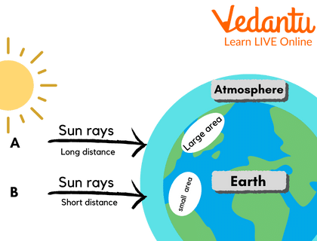
Cloud Cover and sunshine
Plays an important role in the weather at a place.
Not only reduces the amount of insolation but also reduces the amount of radiation from the surface of the earth escaping into space.
Helps in trapping heat near the surface of the earth.
Cloudy days are warmer than cloudless day.
Some clouds also cause rainfall.
Cloudless skies – fair weather

Slide 11
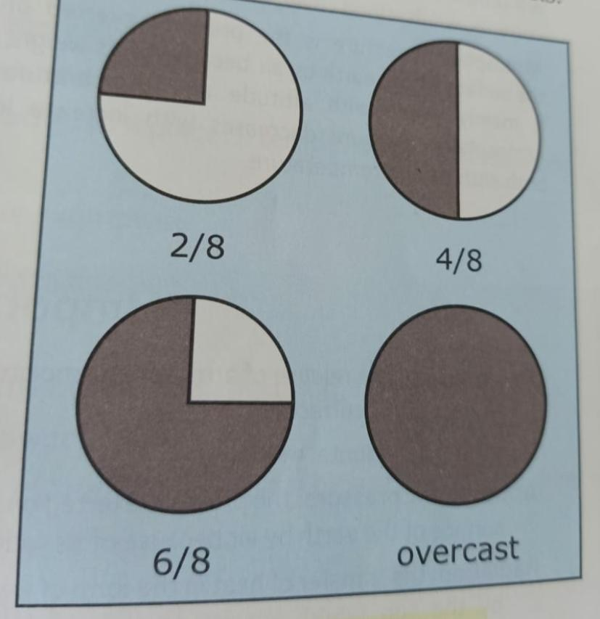
Contd…
Cloud cover in the sky is expressed in eighths of the total sky or oktas, which are shown in weather maps as discs shaded in different proportion.
Example: 2/8 – quarter is shaded
4 /8- half shaded
6/8- three fourths shaded
8/8- completely shaded, indicating overcast conditions.

Slide 12
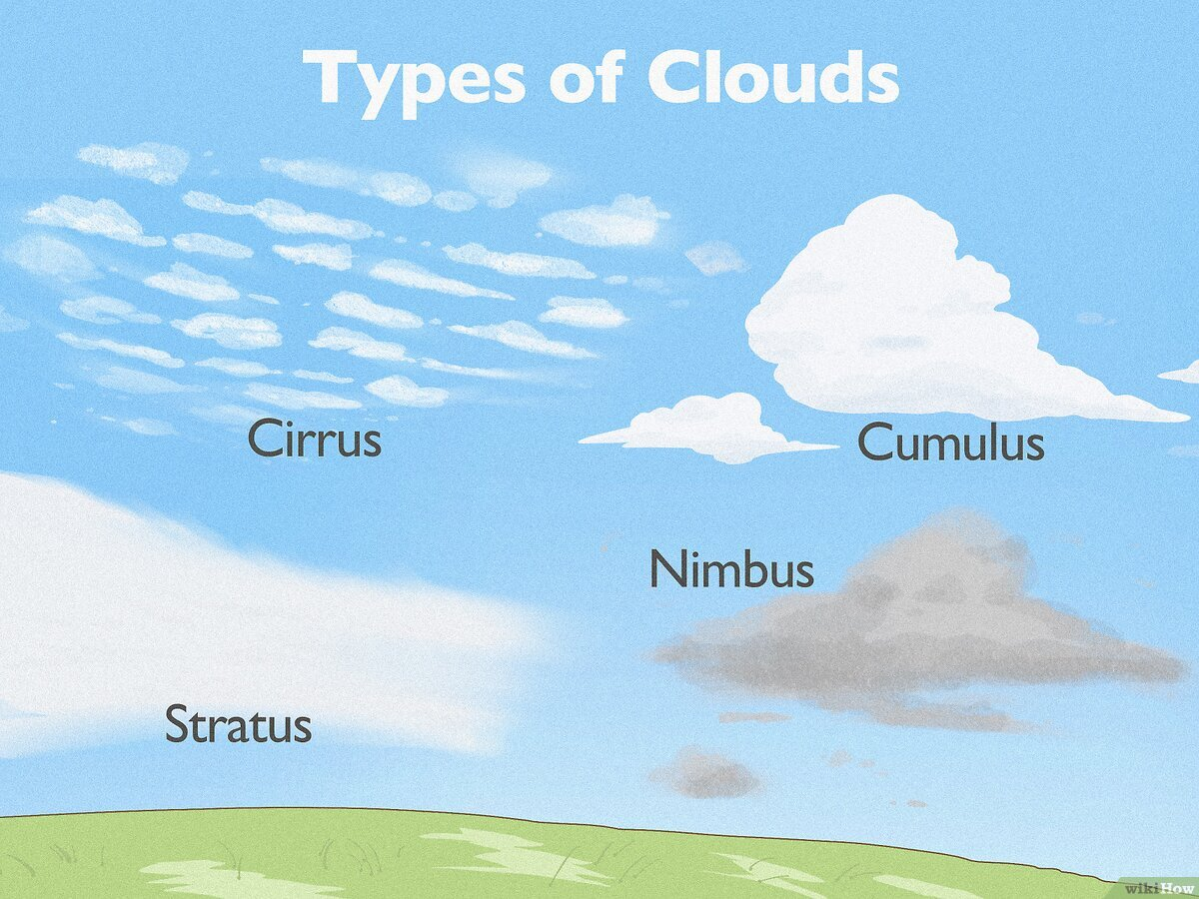

Slide 13
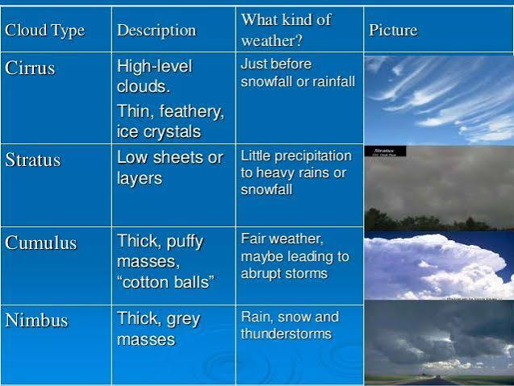

Slide 14
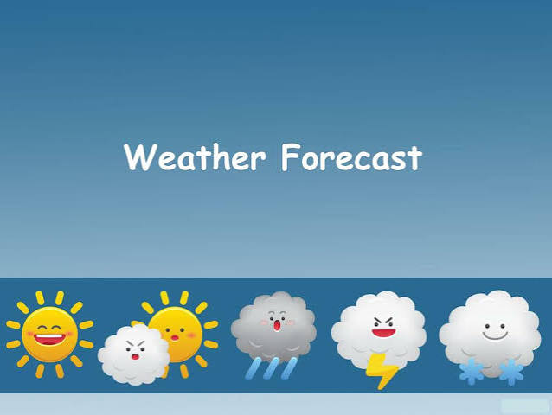

Slide 15
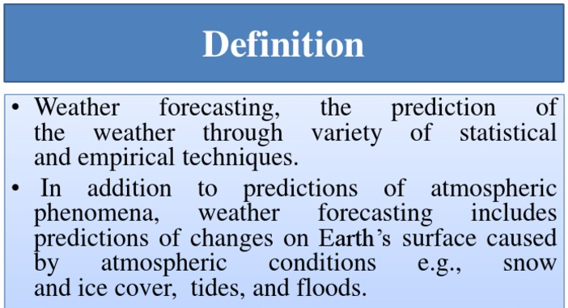

Slide 16
Why Forecasts Matter:
Daily Planning: Helps decide clothing, travel, and outdoor events.
Agriculture: Guides farmers on when to plant, irrigate, or harvest crops.
Disaster Safety: Warns communities ahead of storms, floods, heat waves, and cyclones.
Military operations, geographical expeditions and important sports events, all take into consideration weather forecasts and recordings.

